Slide 1

AI-Based Smart Indoor Air Quality Monitoring and Intelligent Ventilation Management System
MLA0101-ARTIFICIAL INTELLIGENCE AND EXPERT SYSTEMS
Supervised by:
Presented by:
Dr.P.Subramanian
Chaitra(192425217)
Yoga Madha(192425058)
Sai Yashaswini(192425250)
Poojitha(192425337)

Slide 2


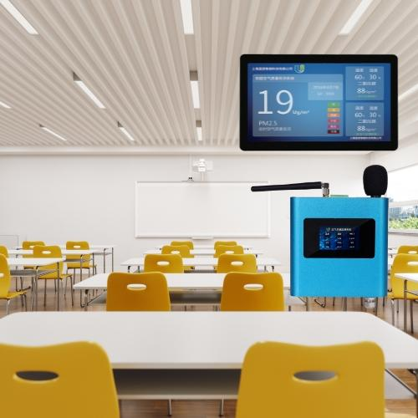
INTRODUCTION
Indoor air quality is important for maintaining a healthy, comfortable, and productive indoor environment.
Poor ventilation can cause the accumulation of gases and pollutants inside enclosed spaces.
Manual monitoring of air quality is difficult because environmental conditions can change continuously.
The proposed system uses an MQ-135 sensor to continuously monitor changes in indoor air quality.
Artificial Intelligence analyzes sensor data and predicts whether ventilation is required.
Based on the AI decision, an Arduino and servo motor automatically control the ventilation door.

Slide 3
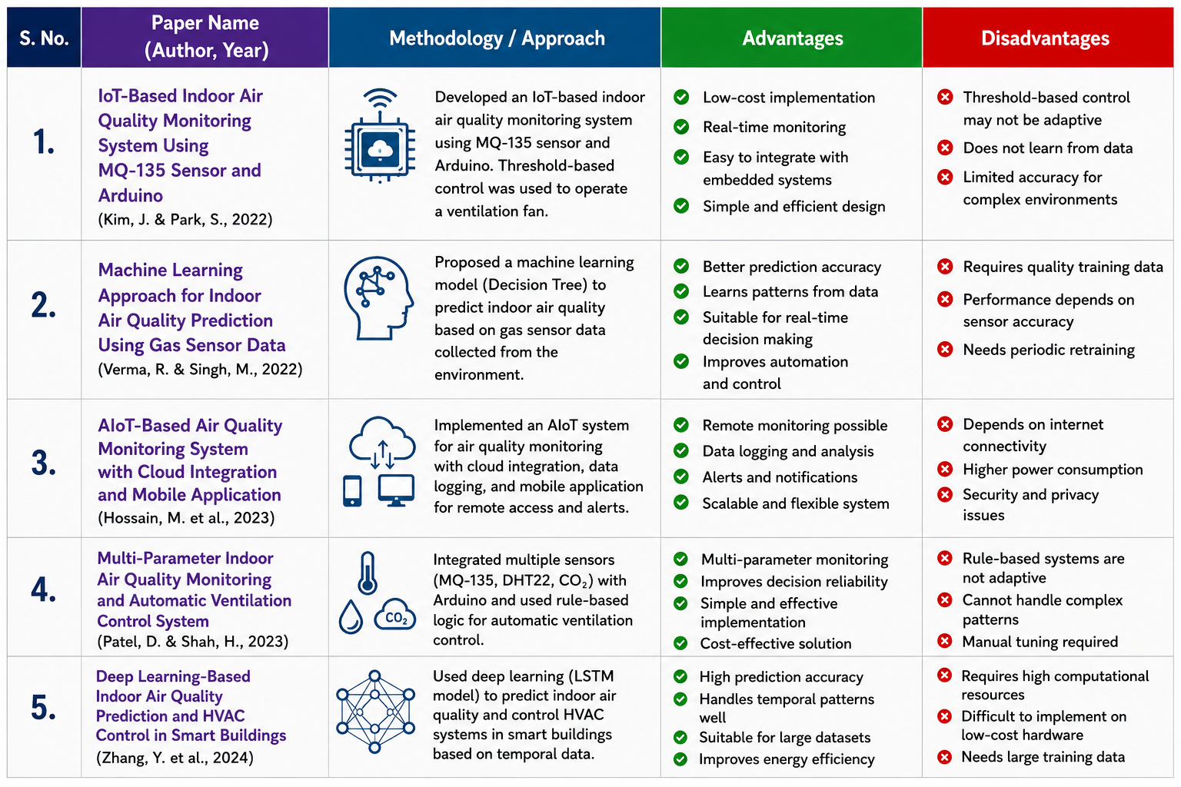
LITERATURE REVIEW

Slide 4
PROBLEM STATEMENT
Indoor air quality can deteriorate when there is insufficient ventilation in enclosed spaces.
Conventional ventilation often depends on manual operation or fixed schedules.
Humans cannot continuously monitor changing air-quality conditions.
A simple threshold-based system may not adapt well to different environmental conditions.
Therefore, an intelligent system is required to analyze sensor patterns and automatically determine ventilation requirements.
The proposed system addresses this problem using AI-based prediction and automatic servo-controlled ventilation.

Slide 5
OBJECTIVES
Monitor Indoor Air Quality Continuously collect air-quality readings using the MQ-135 sensor.
Develop an AI-Based Prediction Model Train a Machine Learning model to identify air-quality conditions and predict ventilation requirements.
Automate Ventilation Control a servo-operated door automatically according to the AI prediction.
Reduce Manual Intervention Provide automatic and condition-based ventilation without requiring continuous human monitoring.
Analyze System Performance Record sensor readings and ventilation actions to evaluate the effectiveness of the proposed system.

Slide 6
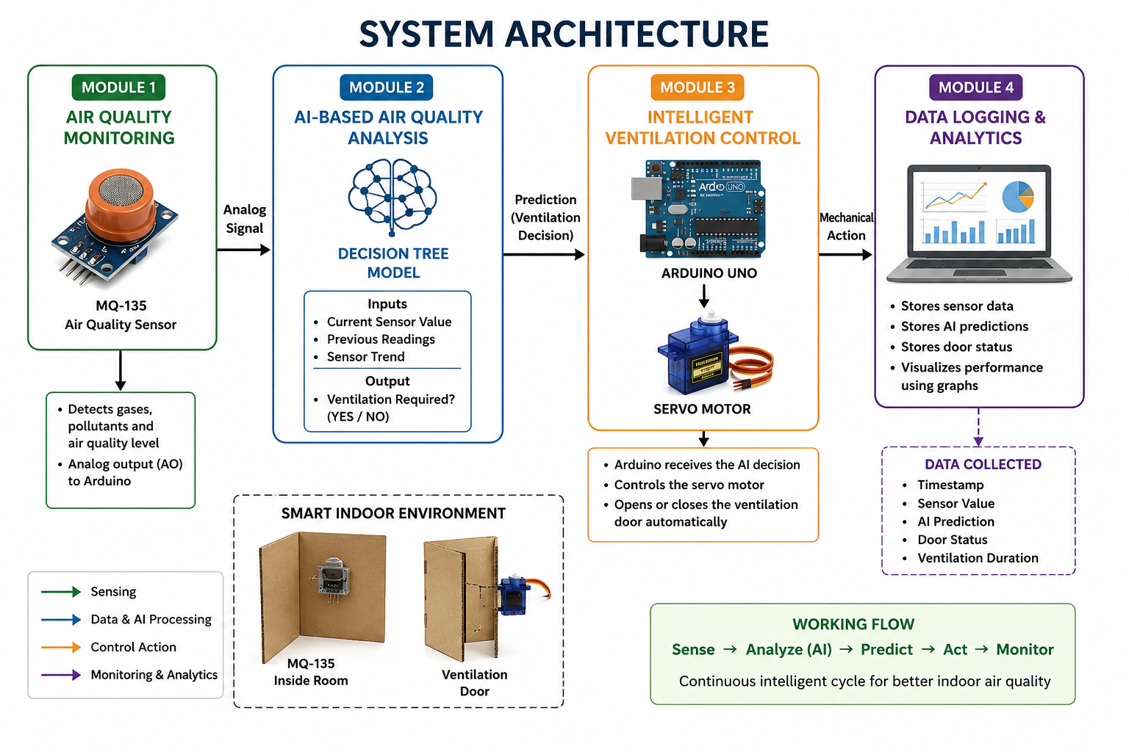

Slide 7
MODULE 1:Indoor Air Quality Monitoring
What it does: Continuously detects changes in indoor air quality and provides real-time sensor data to the system.
Technique Name: Real-Time Sensor-Based Data Acquisition
How Technique is Implemented: The MQ-135 sensor is placed inside the cardboard room and connected to the Arduino through its analog output. The Arduino continuously reads the sensor values and sends them for further processing and AI analysis.

Slide 8
MODULE 2:AI-Based Air Quality Analysis
What it does: Analyzes the collected sensor data and predicts whether ventilation is required.
Technique Name: Decision Tree Machine Learning
How Technique is Implemented: Sensor readings are collected to create a dataset containing air-quality conditions and corresponding ventilation decisions. A Decision Tree model is trained using this data. During real-time operation, new sensor readings are given to the trained model, which predicts whether ventilation is required.

Slide 9
MODULE 3:Intelligent Ventilation Control
What it does: Automatically opens or closes the ventilation door based on the AI prediction.
Technique Name: Servo-Based Automated Actuator Control
How Technique is Implemented: The AI model generates a ventilation decision. Arduino receives the decision and controls the servo motor. If ventilation is required, the servo rotates to open the cardboard door. When ventilation is no longer required, the servo returns to its original position and closes the door.

Slide 10
Module 4: Data Logging & Analytics
What it does: Records sensor readings and system decisions to evaluate the performance of the intelligent ventilation system.
Technique Name: Data Logging and Visualization
How Technique is Implemented: Sensor readings, timestamps, AI predictions, and door status are recorded during operation. The collected data is analyzed using graphs to observe air-quality changes and determine how effectively the ventilation system responds to changing conditions.

Slide 11

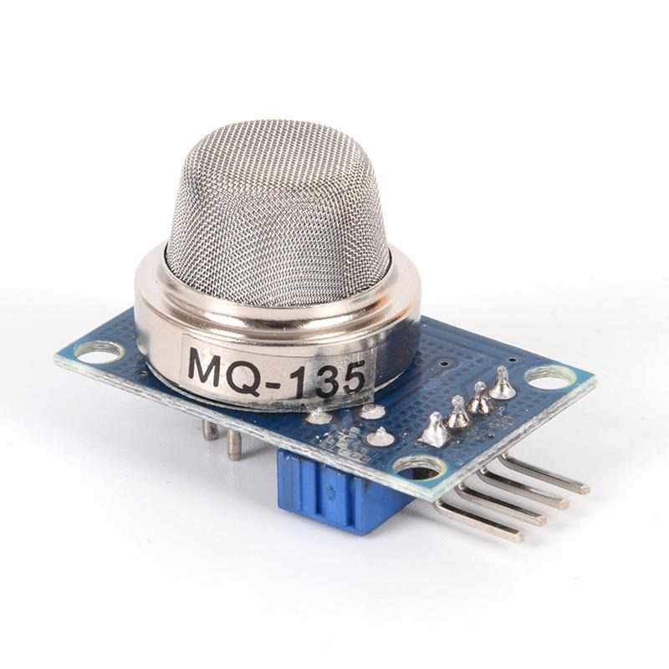
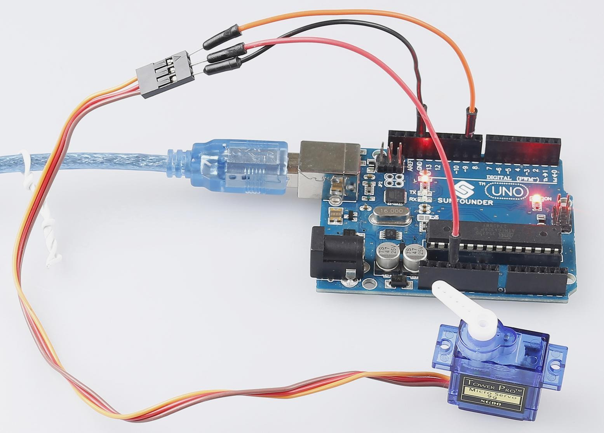
PRODUCT

Slide 12
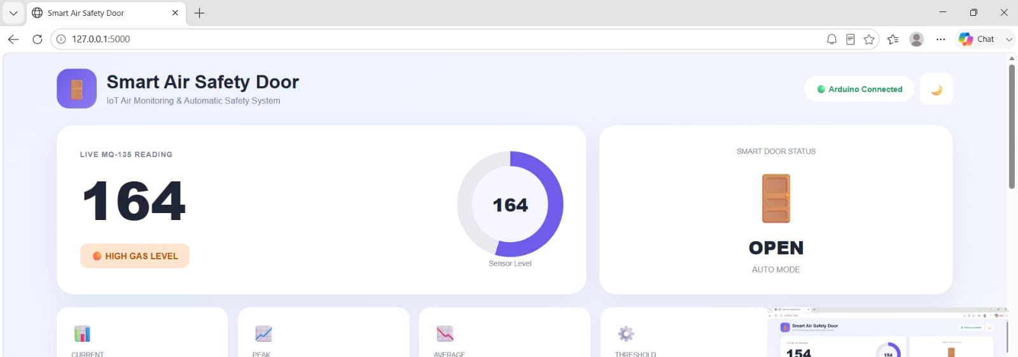
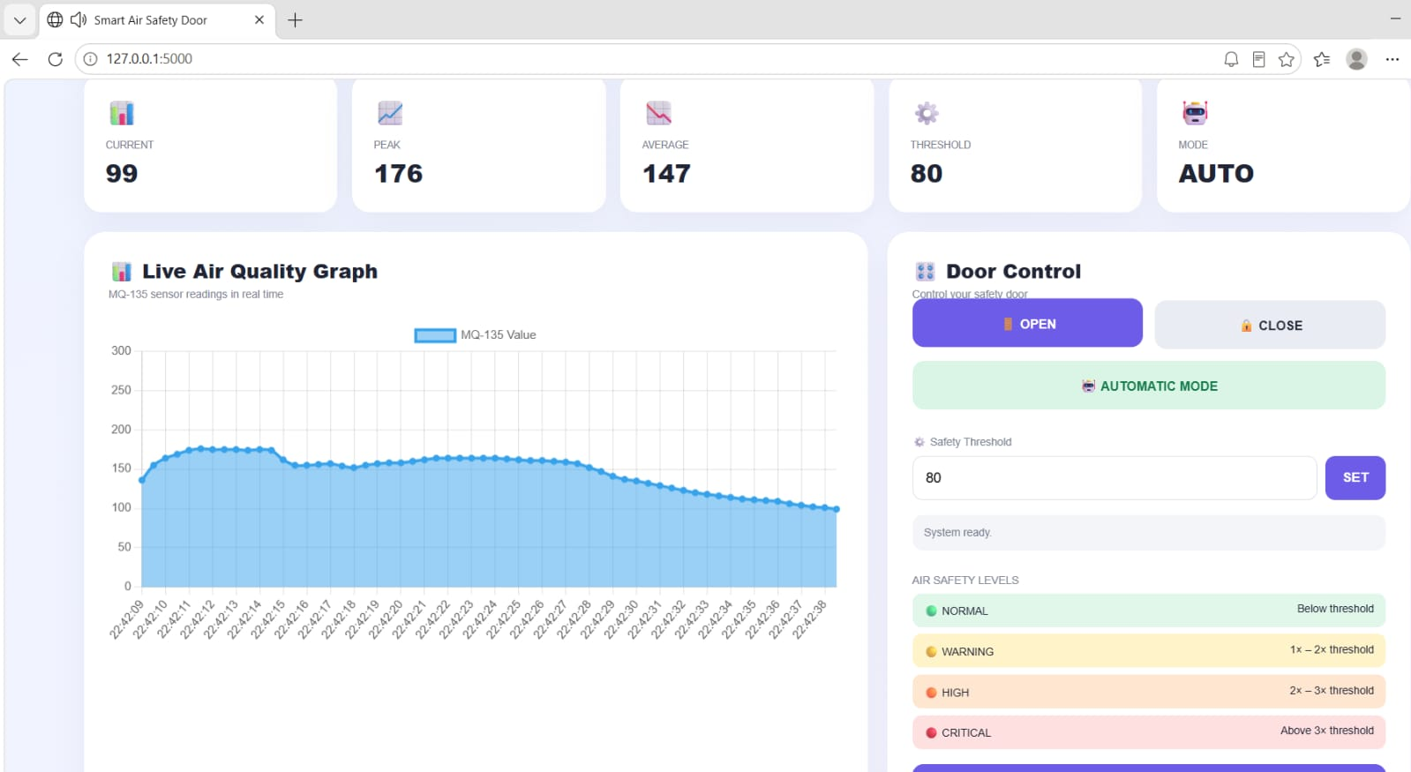

IMPLEMENTATION

Slide 13
APPLICATIONS
Smart Classrooms – Monitors indoor air conditions and supports automatic ventilation.
Offices and Workspaces – Helps maintain a comfortable indoor environment with reduced manual intervention.
Smart Homes – Automatically responds to changes in indoor air quality.
Hospitals and Laboratories – Supports continuous monitoring of indoor environmental conditions.
Factories and Industrial Areas – Can provide early detection of poor air-quality conditions.
Smart Buildings – Can be scaled to multiple rooms and integrated with intelligent building-management systems.

Slide 14
FUTURE SCOPE
Accurate CO₂ Sensor Integration – Replace MQ-135 with an NDIR CO₂ sensor for accurate ppm measurements.
Temperature and Humidity Monitoring – Add DHT22 or similar sensors for multi-parameter environmental monitoring.
PM2.5 and Occupancy Detection – Add particulate-matter and occupancy sensors for better air-quality analysis.
Advanced AI Models – Compare Decision Tree, Random Forest, XGBoost, and neural-network models.
IoT and Cloud Integration – Enable remote monitoring, data storage, and real-time notifications.
Smart HVAC Integration – Connect the system with fans, air conditioners, or automated ventilation systems.

Slide 15
CONCLUSION
The system provides a low-cost approach to intelligent indoor air-quality monitoring.
The MQ-135 sensor continuously detects changes in indoor air conditions.
Collected sensor data can be analyzed using a Machine Learning model.
The AI model predicts whether ventilation is required based on learned sensor patterns.
Arduino and a servo motor automatically control the ventilation door.
The project demonstrates the integration of AI, sensors, embedded systems, and automation for smart indoor environments.

Slide 16
REFERENCES
Nguyen, T.-P. (2025). AIoT-Based Indoor Air Quality Prediction Using Hybrid Deep Learning. Journal of Building Engineering.
Garcia et al. (2025). IoT-Based Air Quality Monitoring and AI Technologies: A Systematic Review. Artificial Intelligence Review.
Ramadan et al. (2025). Federated Learning-Enabled IoT Framework for Indoor Air Quality and HVAC Optimization. Journal of Building Engineering.
Li et al. (2024). Estimating Air Change Rate in Mechanically Ventilated Classrooms Using CO₂ Sensors. Environmental Science & Technology.
Zhang et al. (2024). Quantifying Indoor Air Quality and Ventilation Using Machine Learning. Building and Environment.
ASHRAE (2023). Standard 241: Control of Infectious Aerosols.

Slide 17
THANK YOU!

